Slide 1
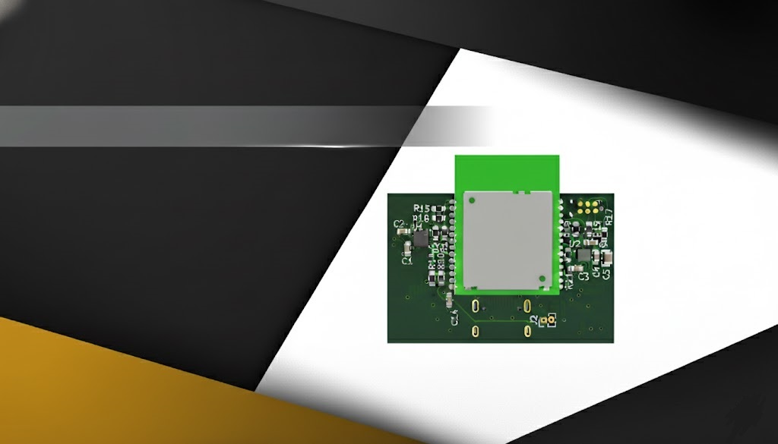

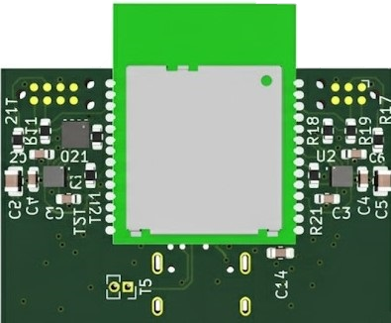
Design of a Wireless Indoor Tracking System for Multi-Sensor Data Acquisition with BLE Channel Sounding
Name: Vasiloglou Athanasios
Advisor: Prof. Evangelos V. Hristoforou, NTUA
Date: 24/10/2025
ECE
NTUA

Slide 2


Introduction
2

Slide 3
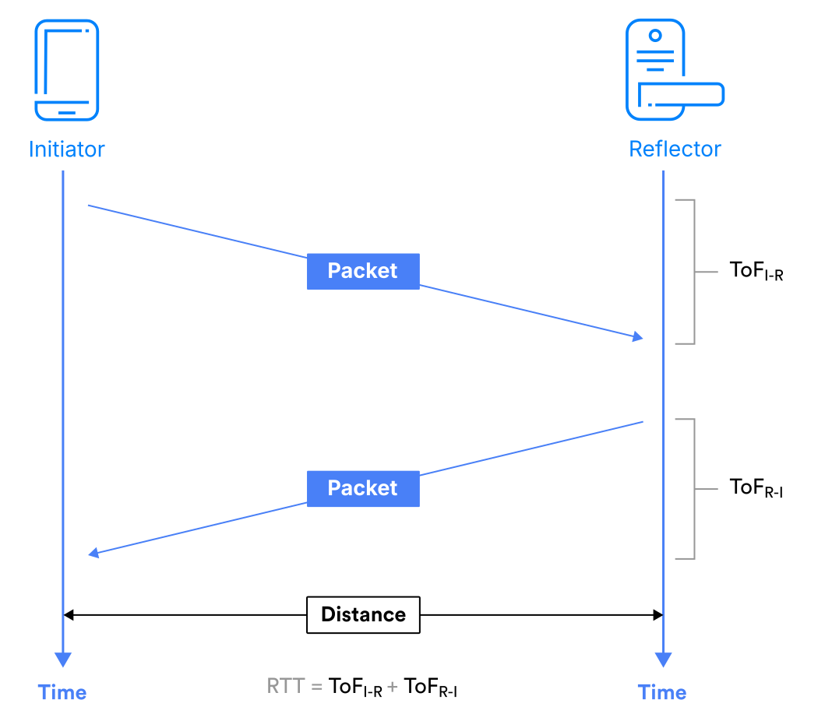
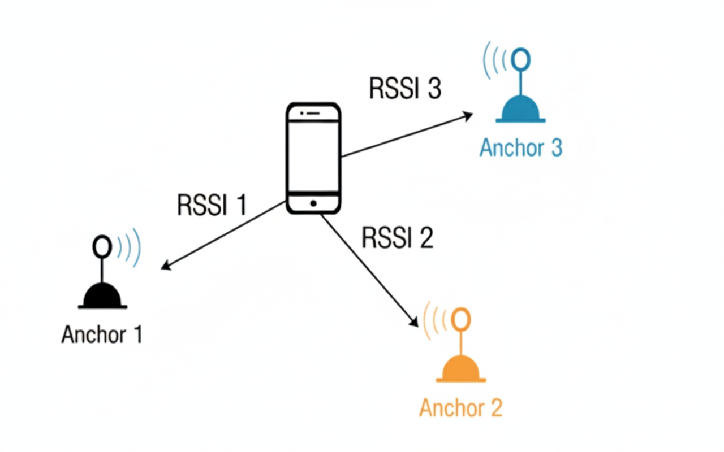
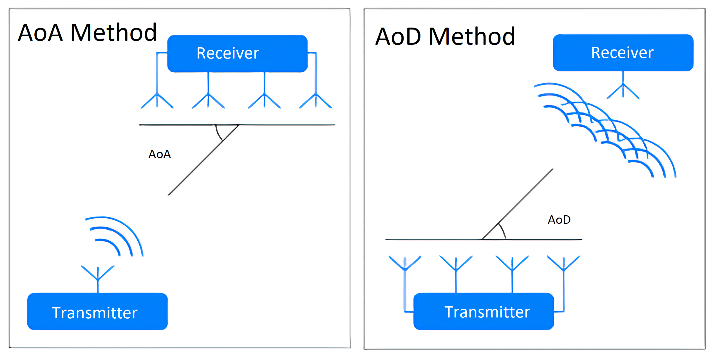
BLE Positioning Approaches
3
RSSI (Received Signal Strength)
AoA / AoD (Direction Finding arrays)
Channel Sounding (BLE 6.0)

Slide 4
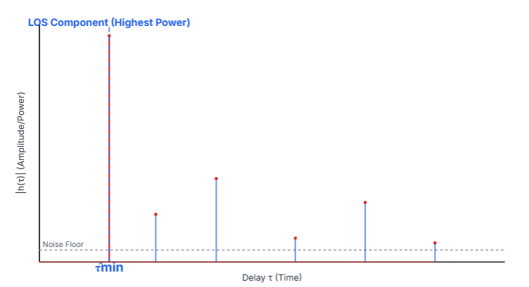
IFFT Based Ranging
4
Inverse Fast Fourier Transform
IFFT Logic
Measure channel transfer H(f) on multiple tones
Apply IFFT → CIR to expose first arrival peak
First detectable path delay → distance = c·τ
Strong in LOS, stable in mild multipath
Q&A

Slide 5
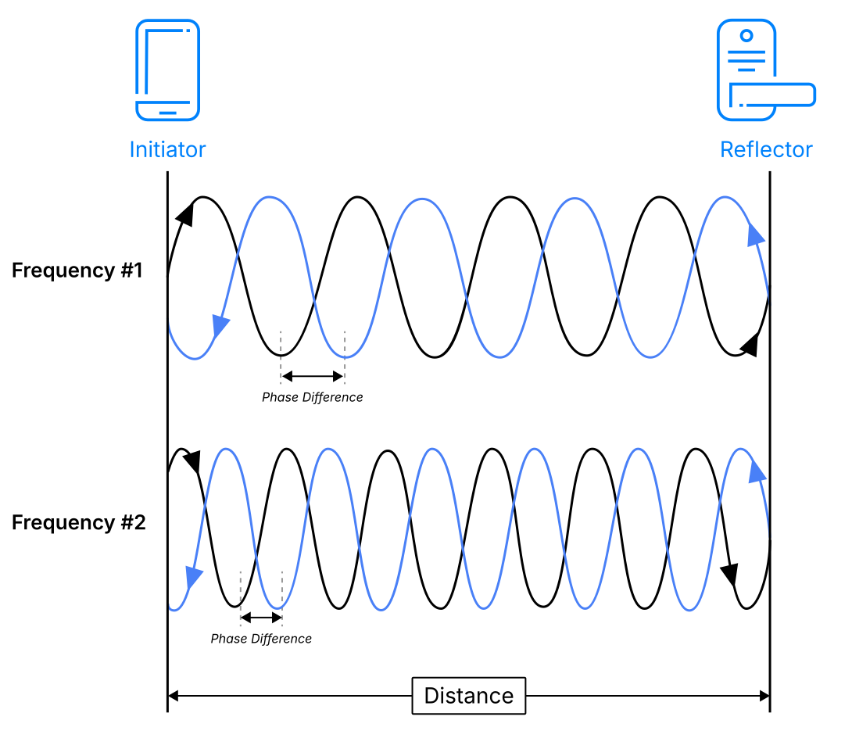
Phase Based Ranging
5
PBR Logic
Phase of tones shifts with distance
Compare across frequencies
Multi-tone fit resolves 2π wrapping
Q&A

Slide 6
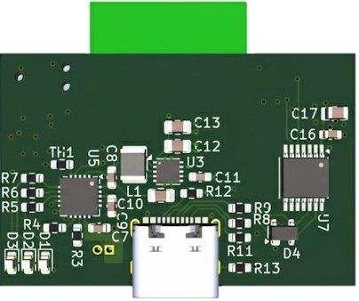
Hardware Design
Q&A

Slide 7
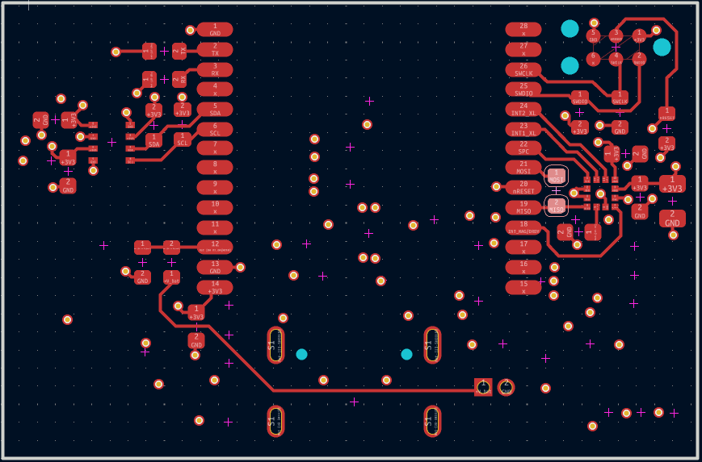
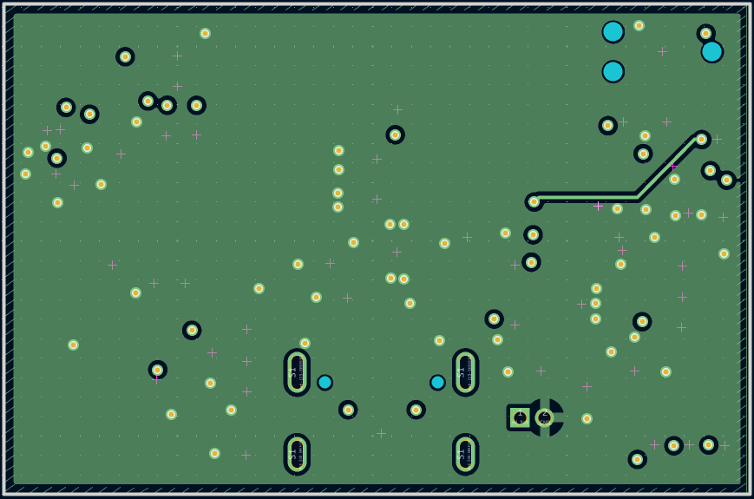
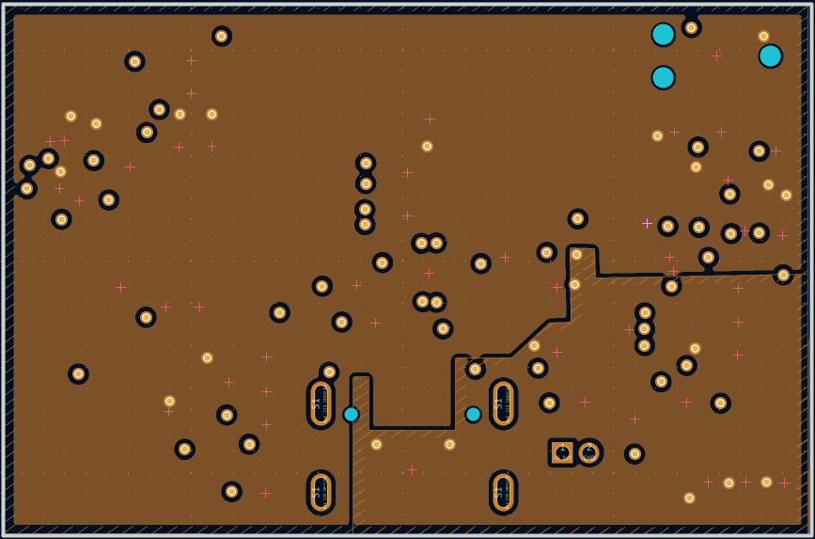
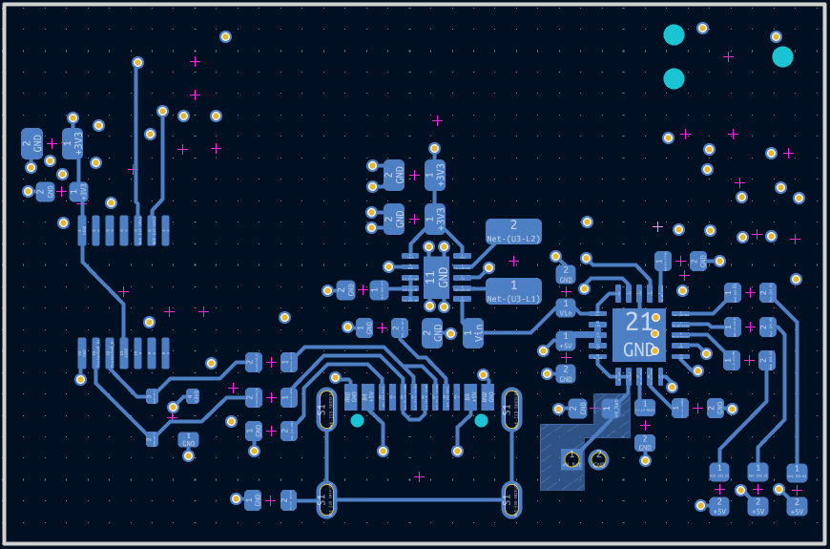
Hardware Design
7
PCB Stack Up
Top layer
Signals
ME54BS01 module
Sensors
First inner layer
Ground
Second inner layer
Power Plane
3V3
5V
Bottom layer
Power Management
USB Differential Pair
Q&A

Slide 8
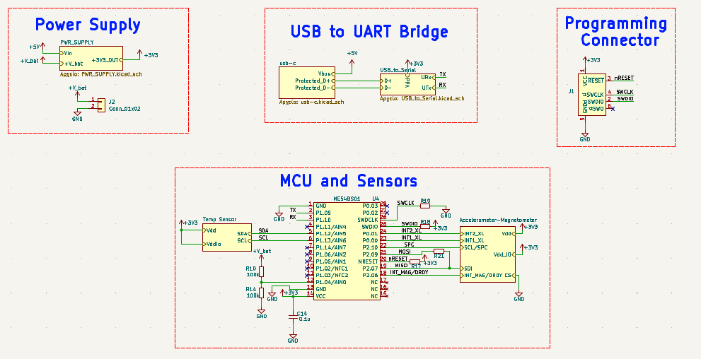
Schematic Diagram
8
Q&A

Slide 9
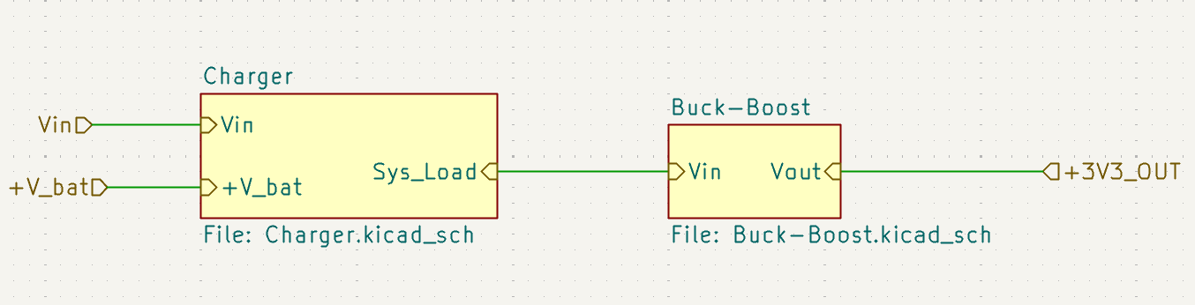
Power Supply
9
Q&A

Slide 10
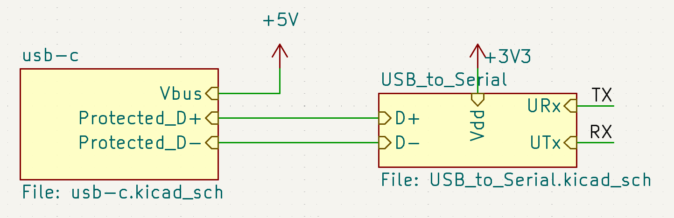
UART – USB Bridge
10
Q&A

Slide 11
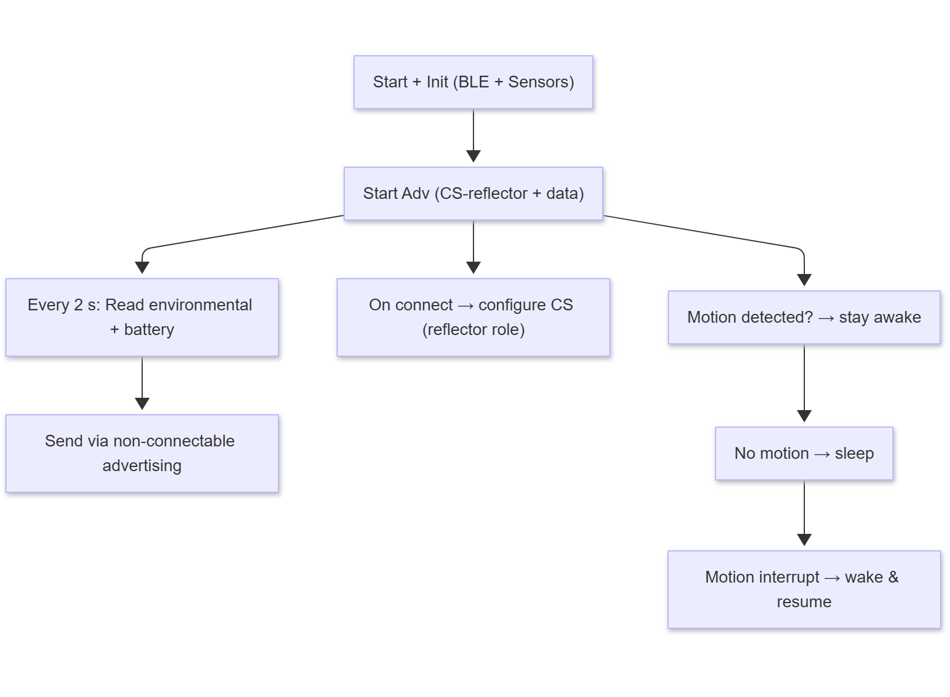
Reflector Firmware
11
Flowchart
Q&A

Slide 12
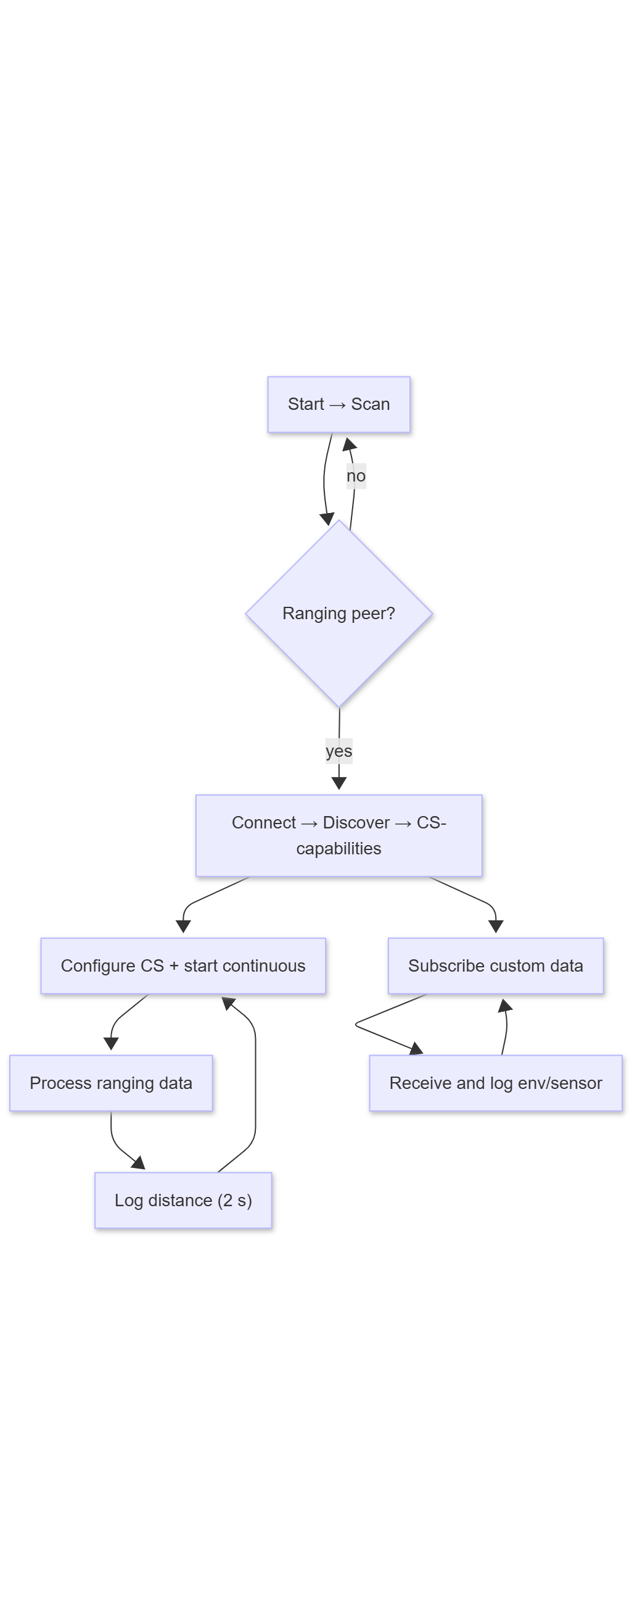
Initiator Firmware
12
Flowchart
Q&A

Slide 13
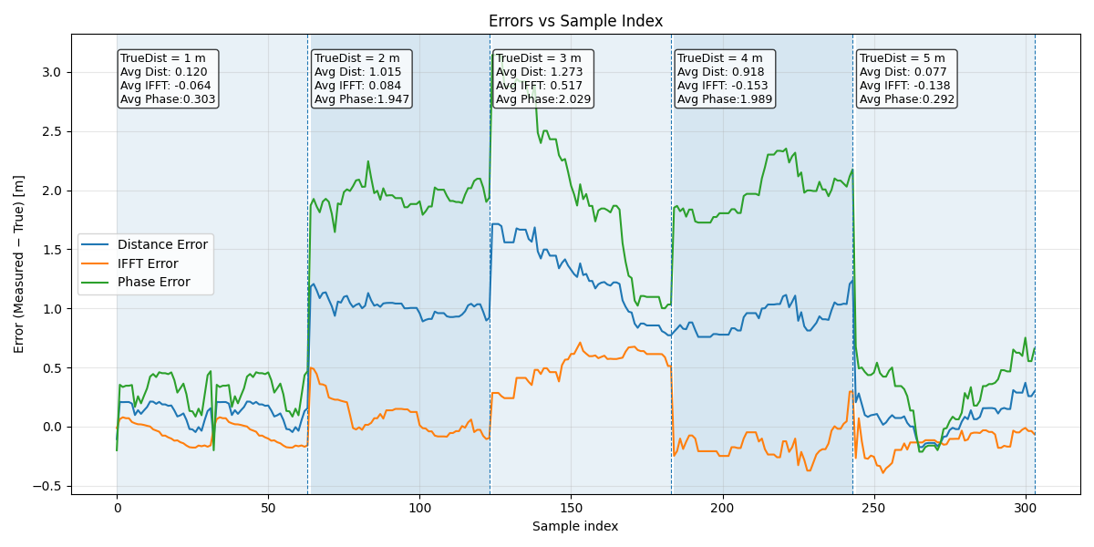
Results
13
First Testing Set up
Average IFFT error : 0.049 m
Average PBR error : 1.312 m
Average Dist error : 0.650 m
Q&A

Slide 14
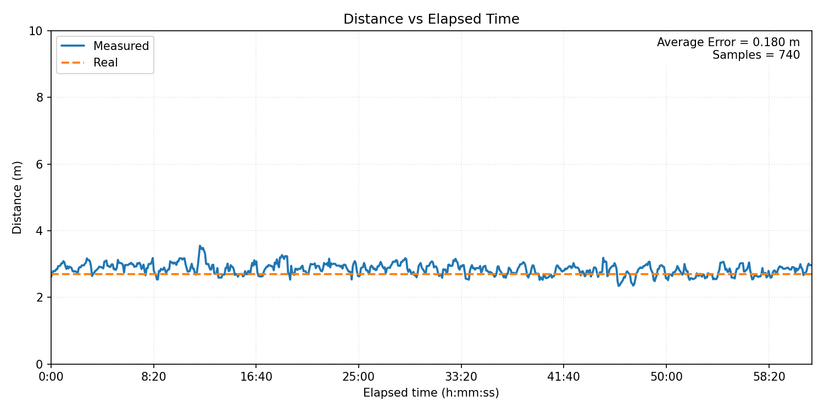
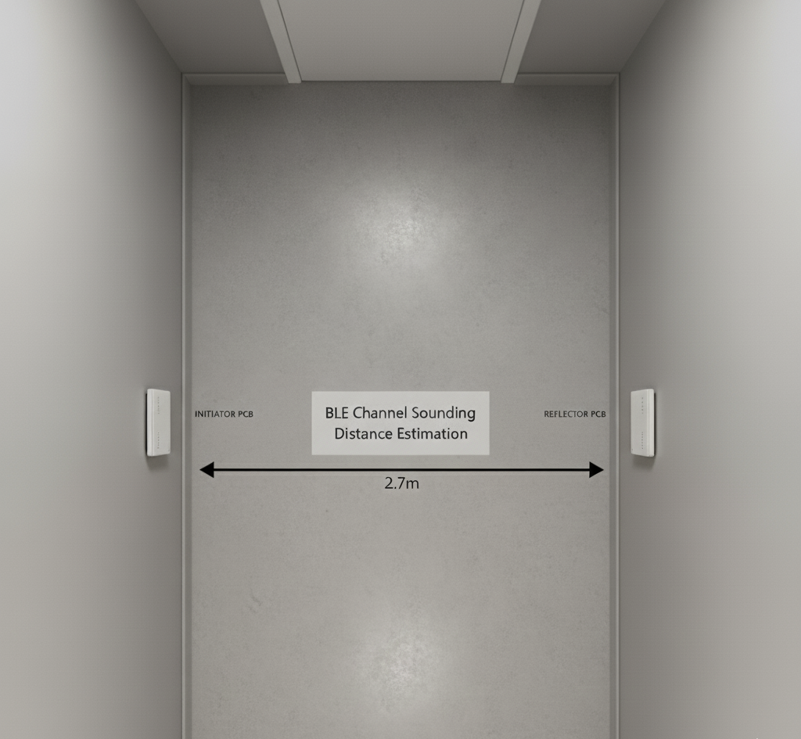
Results
14
Second Testing Set up
Q&A

Slide 15
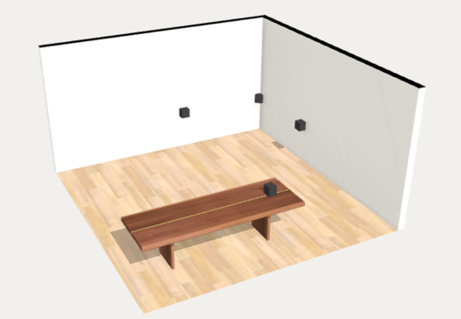
Results
15
Third Testing Set up
Initiator | Distance to Target (m)
Initiator 1 | 4.0
Initiator 2 | 4.5
Initiator 3 | 3.0
Q&A

Slide 16
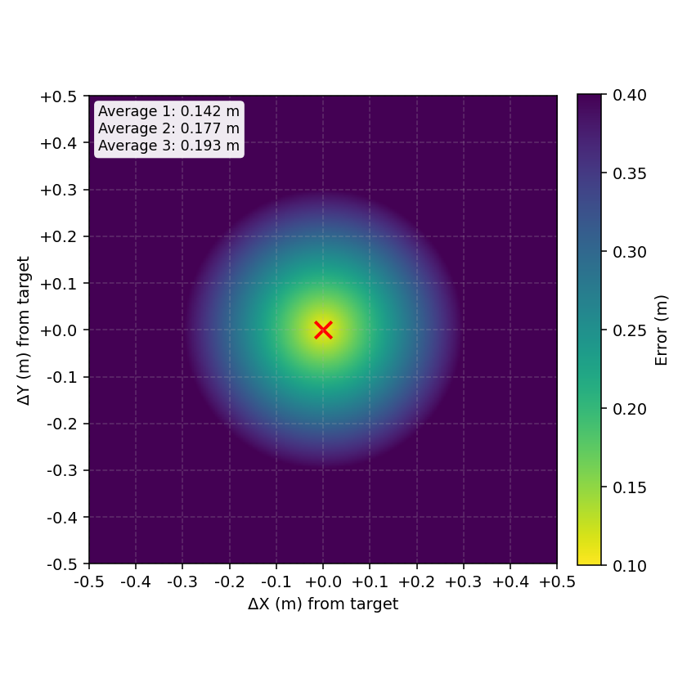
Results
16
Error Heat Map
Initiator | Average error (m)
Initiator 1 | 0.142
Initiator 2 | 0.177
Initiator 3 | 0.193

Slide 17
17
Conclusions and Perspectives
17
Results
Summary
Sub-meter ranging achieved
Modular & scalable Solution
Cost-effective design
Further Work
Complete real-time supervision Software
Anchor Hardware Optimization
Q&A
17

Slide 18

Thanks for your Attention!
18
Q&A
Upright Conventional Design
P22 σελ.3
FEA Set Up σελ.4
YAW Moments Methods
Yaw Moment Diagrams & SkidPad Competition σελ.15
Topology Optomization
Design Space Definition σελ.5
Load cases scenario σελ.6
Hyperworks topology set up σελ.7
Analysis Set Up σελ.8
Results σελ. 9
CAD & Calculations σελ.10
Validation FEA Set Up σελ.11
Comparison Tool σελ.12
Additive Manufacturing With SLM
Final Geometry based on manufacturing needs σελ.16
Thermo-Mechanical Analysis σελ.17
Dimensional Measurements CMM σελ.18
CONCLUSIONS & PERSPECTIVES

